Slide 1
GLSL Basic Exercises
(OpenGL Shading Language)
Advanced Graphics Programming

Slide 2
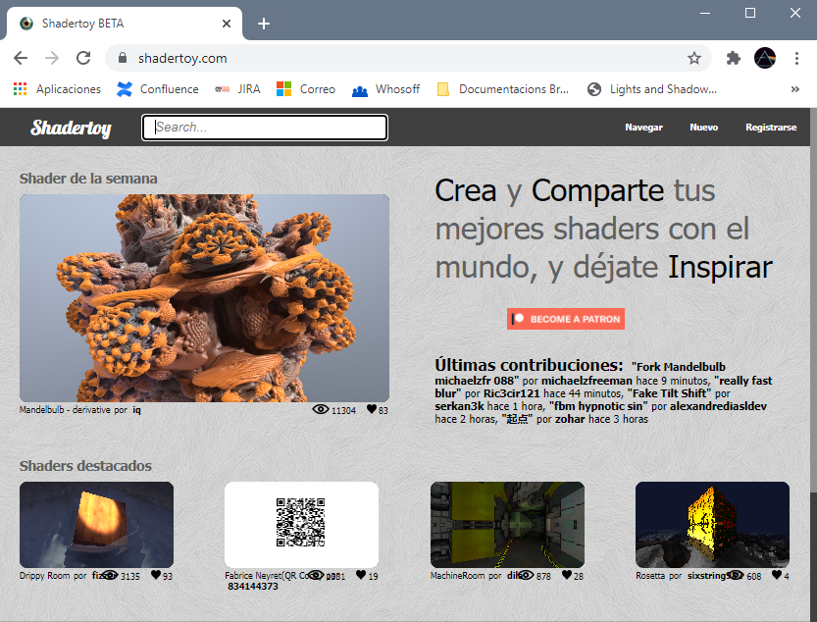
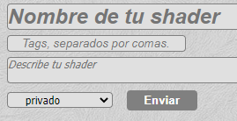
Create an account in ShaderToy.com
Create an account in shader toy
You will be able to save your shaders
Create a new shader
Keep your shader private
All this are tests, help maintaining the public gallery clean
(an alternative to ShaderToy is http://glslsandbox.com/)

Slide 3

Exercise 1

Slide 4

Exercise 2 (mix)

Slide 5
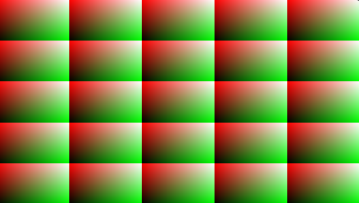
Exercise 3 (mod)

Slide 6


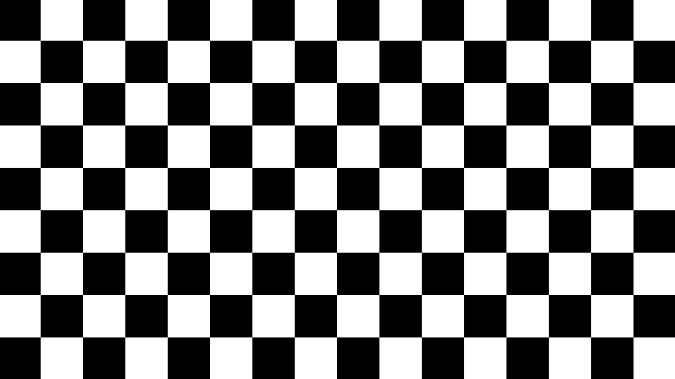
Exercises 4, 5, 6 (floor and mod)

Slide 7

Exercise 7 (smoothstep)

Slide 8
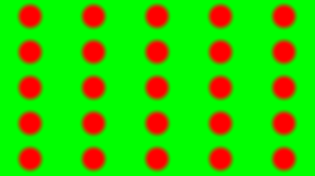
Exercise 8 (smoothstep and mod)

Slide 9
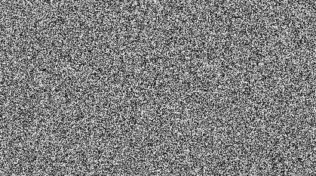
Exercise 9 (custom hash function)
https://gist.github.com/patriciogonzalezvivo/670c22f3966e662d2f83

Slide 10

Exercise 10 (per-tile hash)

Slide 11
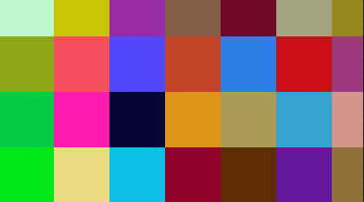
Exercise 11 (per-tile color)

Slide 12

Exercise 12 (per tile displacement)

Slide 13

Exercise 13 (noise value - smoothstep, mix)

Slide 14
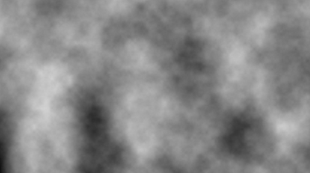
Exercise 14 (Fractional Brownian motion)

Slide 15
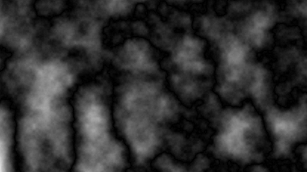
Exercise 15 (ridged fBm)

